Slide 1
How to make your
Big Summer Garden Party
Bunting
#BigSummerGardenParty
#WorldFriendshipDay2020

Slide 2
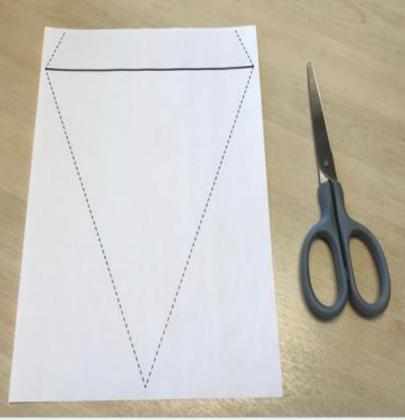
1) Make your Flags
To print out the template:
Download and print the template from amandasolloway.org.uk
Cut along the dotted lines

Slide 3
To Make Your Own template
Take an A4 piece of paper long ways up (portrait)
Fold over about 2 cm at the top

Slide 4
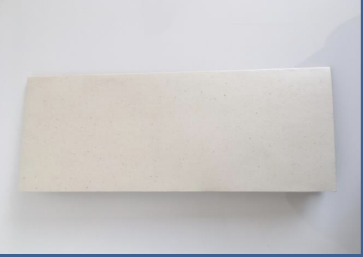
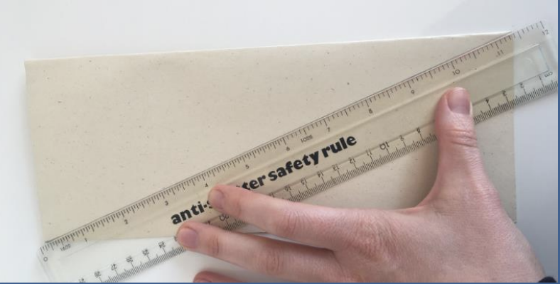
Fold the paper in half long ways
Draw a line diagonally on the outside of the
paper from top of the fold to the bottom

Slide 5
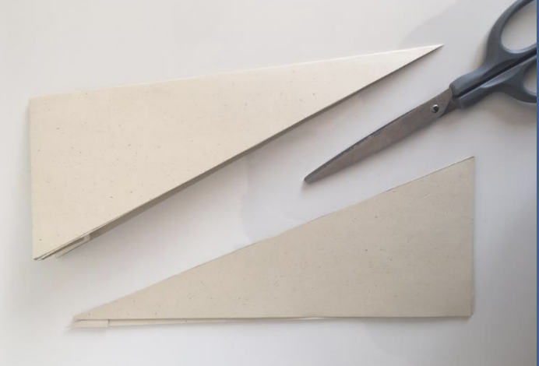
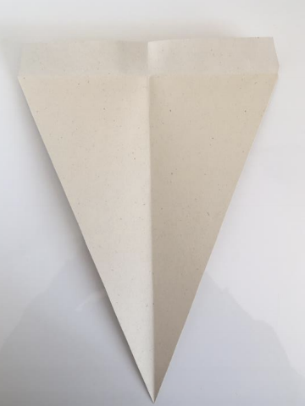
Cut along that line through both sides of the paper
Unfold your paper

Slide 6
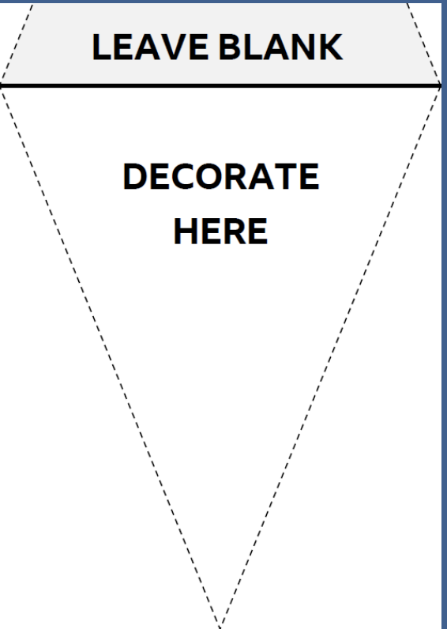
Decorate Your Bunting
Decorate the main triangle, but leave the top strip blank
You can decorate with anything you want – Paint, Pencils, Collage, Glitter, Stickers, Crayons, Pens or anything else you have at home!

Slide 7
You can draw anything that inspires you but here are some ideas if you get stuck:
Sunflowers and the sunshine
The person who inspires you the most
Your friends and family
Something that brings you happiness
A message of kindness and friendship
A summer scene

Slide 8
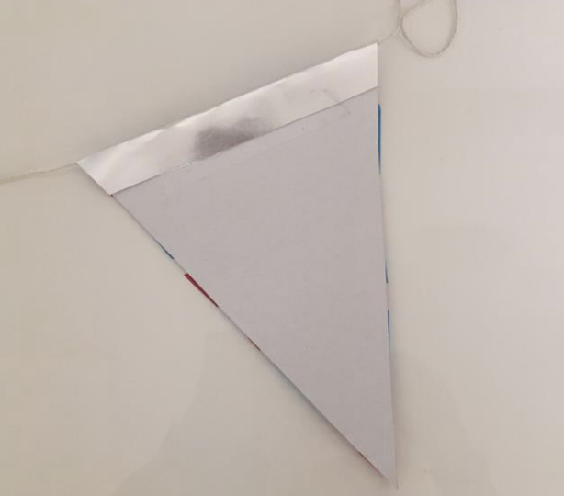
3) Construct Your Bunting
When you’ve decorated all of your triangles, fold along the solid black line to make a flap
Put the flap over your string or ribbon and glue or tape the flap into place

Slide 9
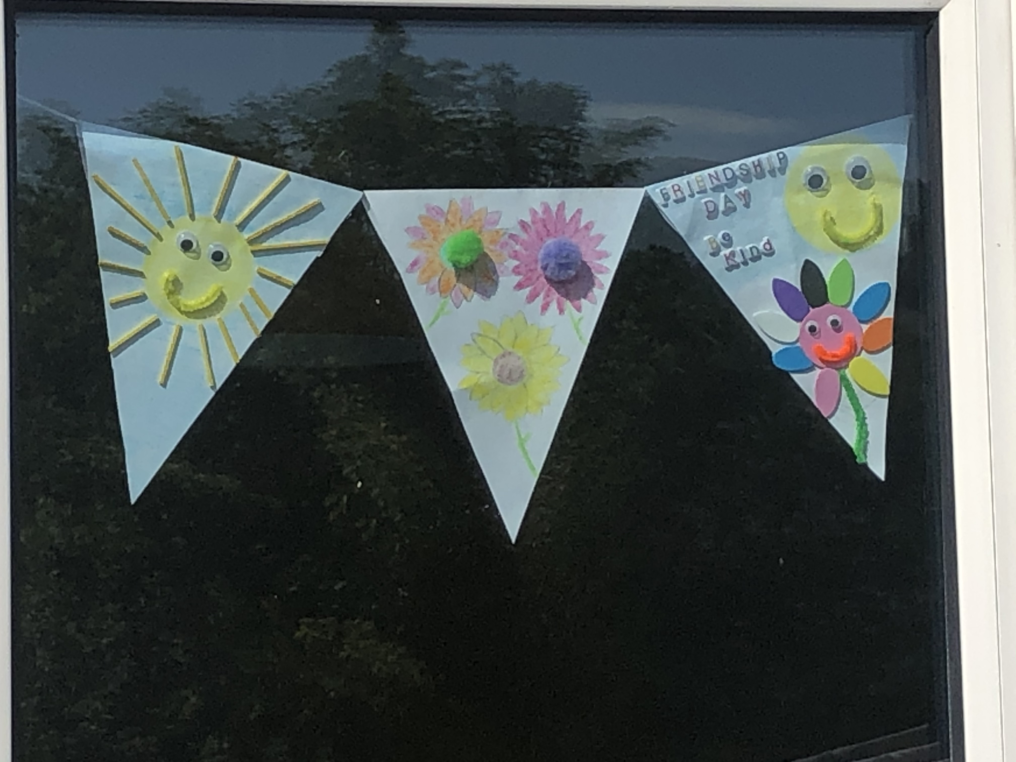
Leave a gap between each triangle and keep adding them until you’re done.
Leave a spare piece of string/ribbon on each end for hanging
Hang your bunting in your window for people to
enjoy!

Slide 10
We’d love to see your bunting
We’d love to see your bunting creations
Send us your photos or tag us in your social media posts –
Don’t forget to use the hashtag #BigSummerGardenParty
For more information please email
BigSummerGardenParty@gmail.com

